Slide 1

I
ARTIFICIAL INTELLIGENCE

Slide 2
II
OBJECT
DETCTION SYSTEM
Team Members
E. Venkata Srujan(2019250)
M. Gnana Sundar(2019286)
Instructor
Dr. Kusum Kumari Bharti

Slide 3
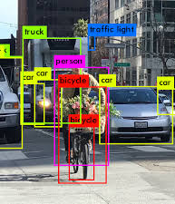
INTRODUCTION
III
We humans mostly can detect the objects we see in an image but for computer vision it is difficult to detect the object.
Computer vision involves working with digital images and videos to deduce some understanding of contents with in these images and videos. Object detection is associated with Computer Vision.

Slide 4
IV
The main aim of object detection is to determine where objects are located in a given image (object localization) and which category each object belongs to (object classification). Object localization refers to identifying the location of one or more objects in an image and drawing the box around their extent. Object classification involves identifying the class of one object in an image. Object detection combines these two tasks and identifies and classifies one or more objects in an image. With this kind of identification and localization, object detection can be used to count objects in a scene and determine and track their precise locations, all while accurately labeling them.

Slide 5
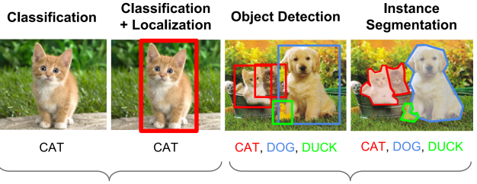
V
With this kind of identification and localization, object detection can be used to count objects in a scene and determine and track their precise locations, all while accurately labeling them.

Slide 6
Literature Survey
VI
The first object detector came out in 2001 and was called the Viola Jones Object Detector .Although, it was technically classified as an object detector, it was primary used for facial detection. It provided a real time solution and was taken by many computer vision libraries at the time.
The first Deep Learning object detector model was called the Over feat Network which used Convolutional Neural Networks (CNNs) along with a sliding window approach. It classified each part of the image as an object/non object and subsequently combined the result to generate the final set of predictions.

Slide 7
MOTIVATION
VII
Our main motivation to select this topic is in present era with the rapidly growing importance in military and security applications visual surveillance has become a necessary area of research for improvement . It is very hard for human operators to monitor for long durations to identify the important events in real-time .
But using this system we can detect the objects in the images of the video continuously in the military area to detect any suspicious activity. And it can be also used in many other areas. This gives us the interest to select this project

Slide 8
VIII
IMPLEMENTATION
There are currently two methods of constructing object Detectors-
the single step approach and the two-step approach. The two step approach has achieved a better accuracy than the former whereas the single step approach has been faster and shown higher memory efficiency. The single step approach classifies objects in images along with their locations in a single step. The two step approach on the other hand divides this process into two steps.

Slide 9
IX
The first step generates a set of regions in the image that have a high probability of being an object. The second step then performs the final detection and classification of objects by taking these regions as input. These two steps are named the Region Proposal Step and the Object Detection Step respectively.
In these years some methods are developed for object detection. But currently the most popular methods are Faster RCNN and YOLO .Faster R-CNN is a two-step approach which is used for object detection, where as YOLO is a single-step approach It takes the entire image in a single instance and predicts the bounding box coordinates and class probabilities for these boxes.

Slide 10
X
The biggest advantage of using YOLO is its superb speed – it’s incredibly fast and can process 45 frames per second. YOLO also understands generalized object representation.
We will use yolo Algorithm for object detection using Tensorflow.Tensorflow is a free and open-source software library for machine learning and artificial intelligence. yolo algorithm firstly divides the image into many grids to assigned an object to a grid, we took the midpoint of the object and based on its location, assign the object to the corresponding grid, Each of these grids is responsible for predicting some bounding boxes.we get many bounding boxes for each object A bounding box describes the rectangle that encloses an object .we need to calculate the IoU(Intersection over Union) for each box.

Slide 11
XI
Now we implement non-max suppression to find the best box, the steps are: Select the box that has the highest score.
Compute its overlap with all other boxes, and remove boxes that overlap it more than a certain threshold which we call iou threshold. Go back and iterate until there are no more boxes with a lower score than the currently selected box.These steps will remove all boxes that have a large overlap with the selected boxes.

Slide 12
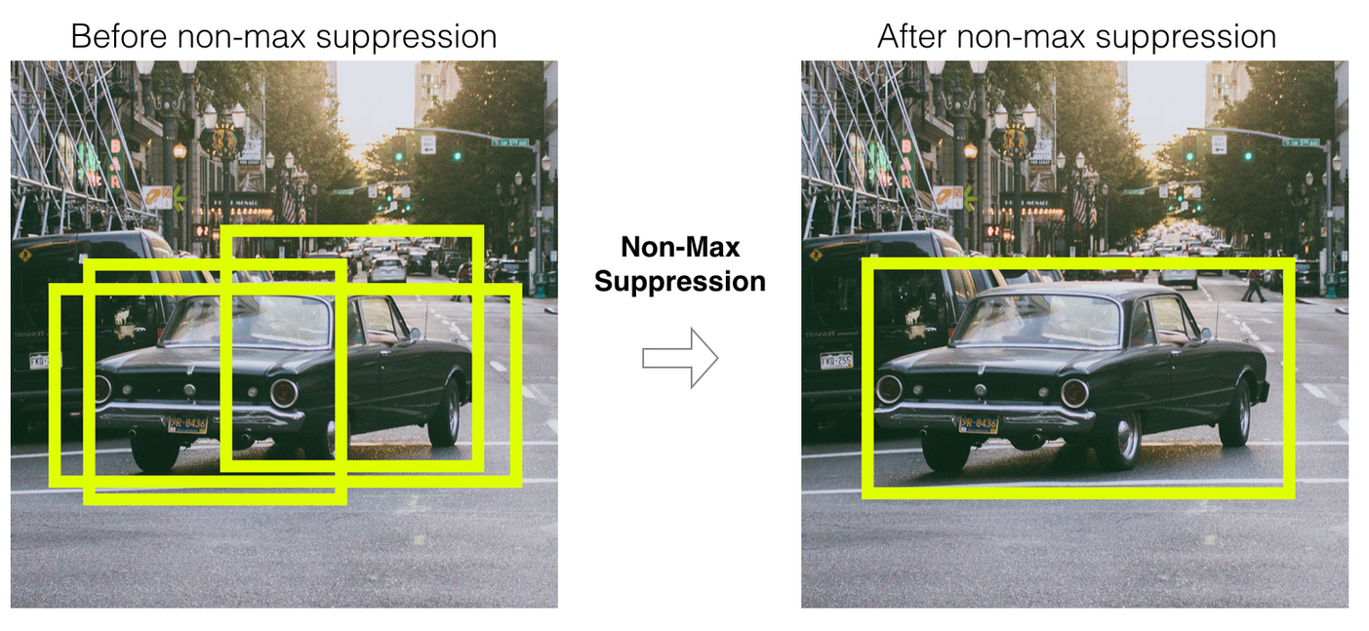
XII

Slide 13
XIII
After predicting the box around the object we are going to use , one of the open source neural network framework called Darknet in Yolo algorithm to predict the object in the box . Darknet is a convolutional neural network that acts as a backbone for the YOLOv3 object detection approach. We use the yolo conv to go through the Darknet layers to using the trained weights files to predict the class of the object in the box based on the class list defined as the class names which contains names of 80 different objects. These trained weights of yolo helps to filter the objects present in the box

Slide 14
XIV
We can now predict the bounding box around the object and the class of the object using the Yolo we pass these predictions as inputs and then we can draw the output of the prediction on the image and then show that predicted bounding box and the class of object on the image
We need to transforming each image and normalizing it in range [0,1] for printing the probability of the object that belongs to the given class

Slide 15
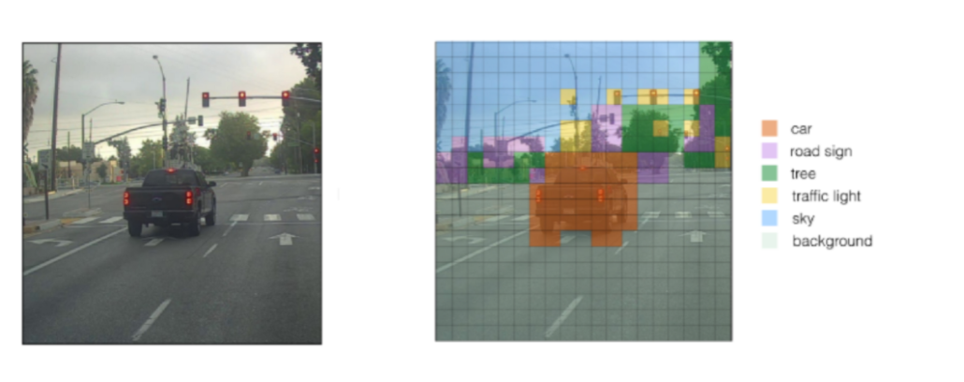
XV

Slide 16
UPGRADATION
XVI
After our implementation we have made some upgradation to our project. In our implemented part it detects object in a given input image .Now we have tried to upgrade it to detect objects in videos. In our upgradation we have also used cv for our yolo algorithm along with tensorflow and darknet. We have used OpenCV to capture real time people images and detect for any faces in the image. OpenCV (Open Source Computer Vision Library) is an open-source BSD-licensed library that includes several hundreds of computer vision algorithms.

Slide 17
XVII
Using cv we are going to capture the video and then we are going to break these videos into frames , these frames can be used in our implementation model to detect the objects in the frames .And also we use the coco names dataset for the classes of objects. So, in these way we can detect the object in the whole video by detecting all the object in all frames.

Slide 18
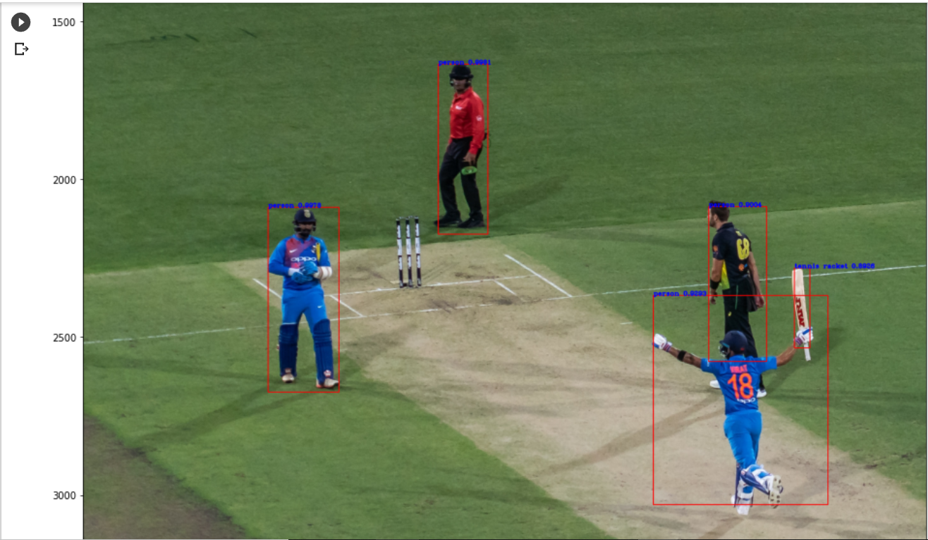
RESULT
XVII
the result obtained after performing the method given above. And after implementing the method, we have tested our model that detects the objects in the picture given. And below are the few examples that we have checked for:

Slide 19
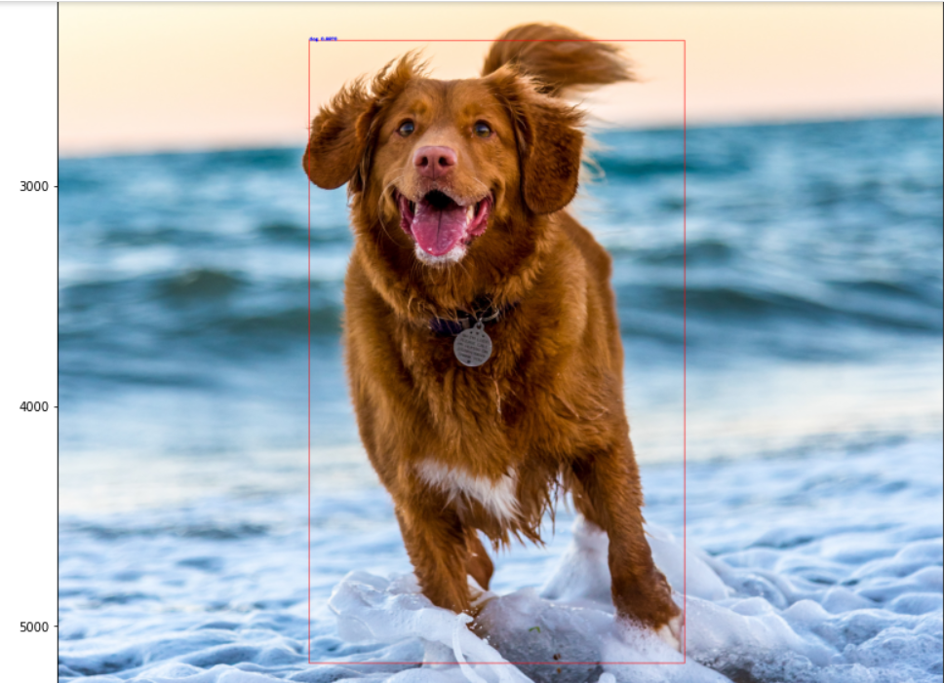
XVIII
VII
We created a system which detects object in an image by bounding box around them and classifies to which class(object ) it belongs to and the probability of these object.

Slide 20
CONCLUSION AND FUTURE SCOPE
XIX
We can conclude that the YOLO algorithm is much faster compared to other algorithms while being able to maintain a good accuracy.
We have a newer version of this algorithm, YOLOv4 which addresses this problem and is more accurate and faster. Overall, YOLO’s speed and accuracy makes it a widely used algorithm for real-time object detection.

Slide 21
Links
Github link : https://github.com/Sundar1872/Object-Detection
Drive link: – https://drive.google.com/drive/folders/1- 0TOcTrnhslTN3utIv-WIgjhrBaUt47P

